Slide 1

My name is Felipe. This is my family.
I am from…
Karen
Ethan

Slide 2


Slide 4


Slide 5







Notes:
Collaborations Services. My team is focused on Microsoft 365 and its applications and licenses. In my role, I learned to use Microsoft Power Platform. It is a low-code platform that spans Office 365, and Azure, Dynamics 365.
I used Business analytics tool, Application Development, Process automation, data connector, and Dataverse.

Slide 6

Checklist Form / Web page

Slide 7


BOUNCE EMAIL PROJECT
Checklist Form
USE OF HTML AND CSS

Slide 8



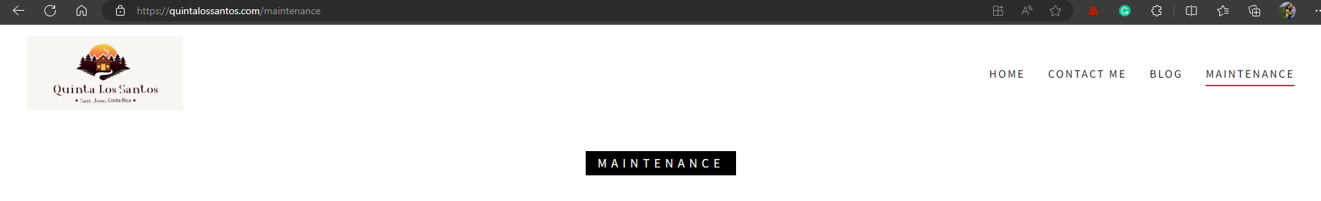
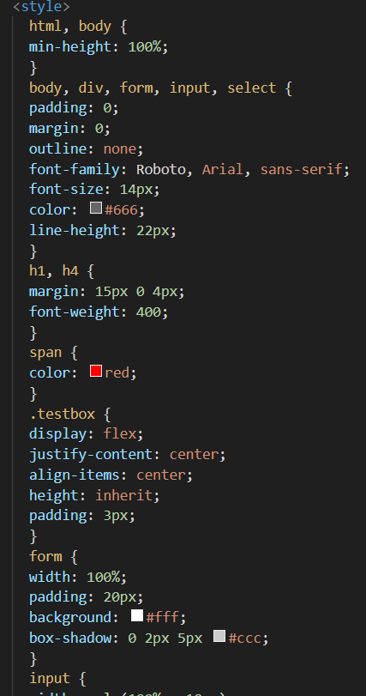
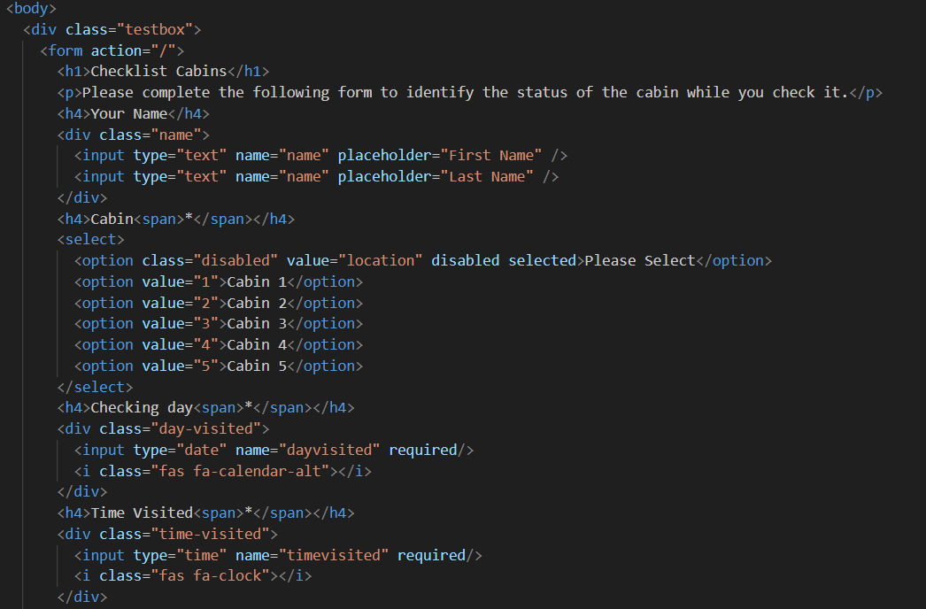
BOUNCE EMAIL PROJECT
POWER AUTOMATE
Notes:
LINK: https://quintalossantos.com/maintenance

Slide 9
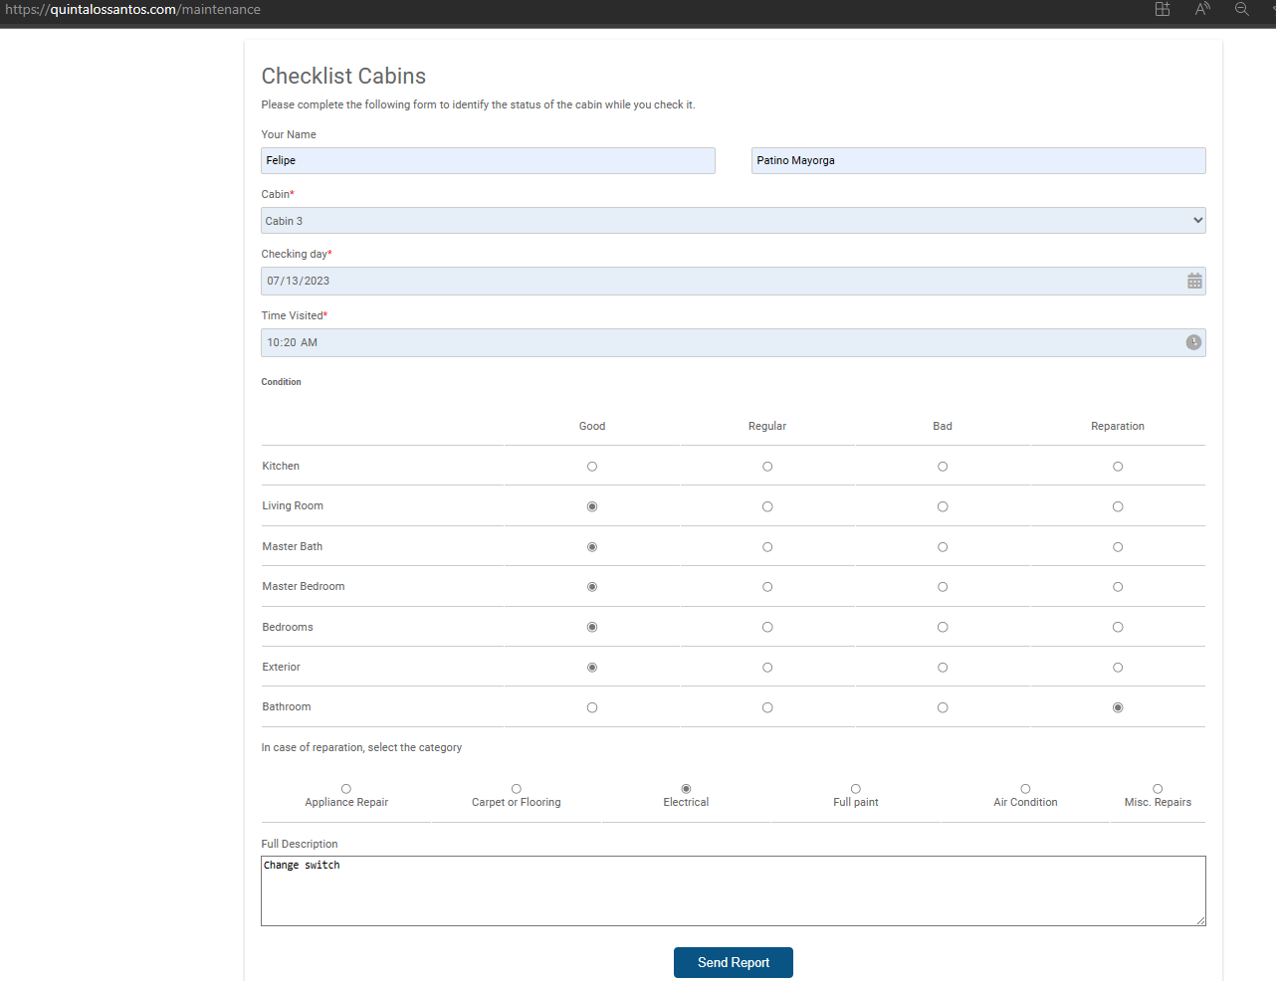
BOUNCE EMAIL PROJECT
POWER AUTOMATE

Slide 10
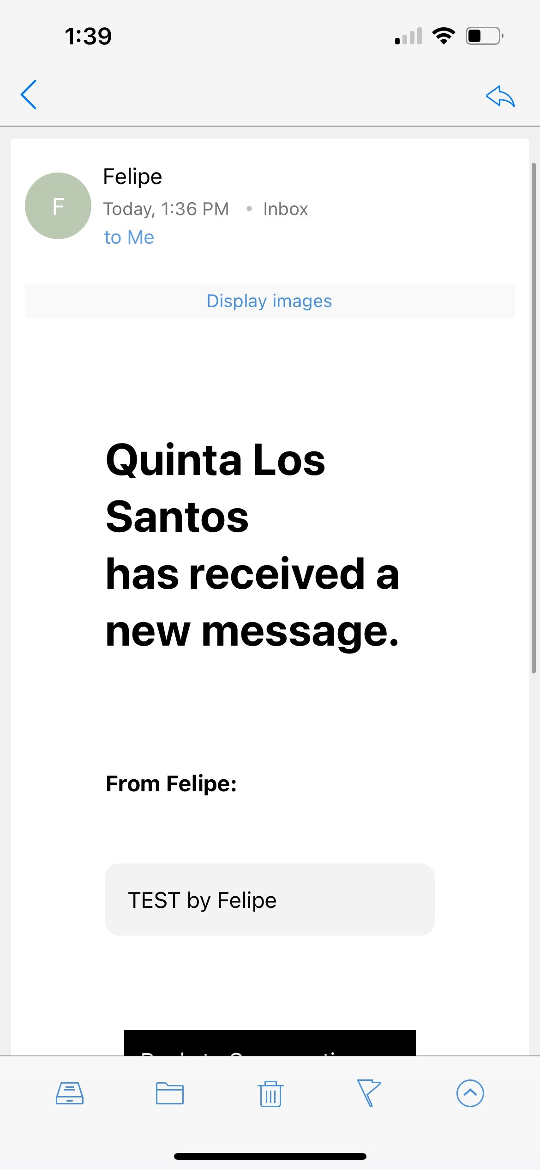
BOUNCE EMAIL PROJECT
POWER AUTOMATE

Slide 11

PYTHON

Slide 12
BOUNCE EMAIL PROJECT
PYTHON
Purpose: The purpose of the program is to assist Quinta Los Santos in managing its product inventory by facilitating the insertion, updating, and deletion of items. It also aims to generate individual reports for employees based on their work hours and inventory usage
Notes:
Python Program Project CIT 295
Purpose: The purpose of the program is to assist Quinta Los Santos in managing its product inventory by facilitating the
insertion, updating, and deletion of items. It also aims to generate individual reports for employees based on
their work hours and inventory usage
Steps:
• Use a CSV file to manage the company's product inventory.
o The user can add, delete, or modify products in the file.
o The user can view the inventory using a menu option.
• Work Report (Date will be added in each step)
o The worker can select items from the inventory, ensuring it remains updated.
o Once the job starts, the worker will input the Work Order, name, and quantity of items.
Afterward, the program will display a message based on the inputs. The worker's name will be associated with the chosen item in the inventory until the job is completed.
o When the job is finished, the worker can choose an option to input the work time and provide a report on the finished items.

Slide 13
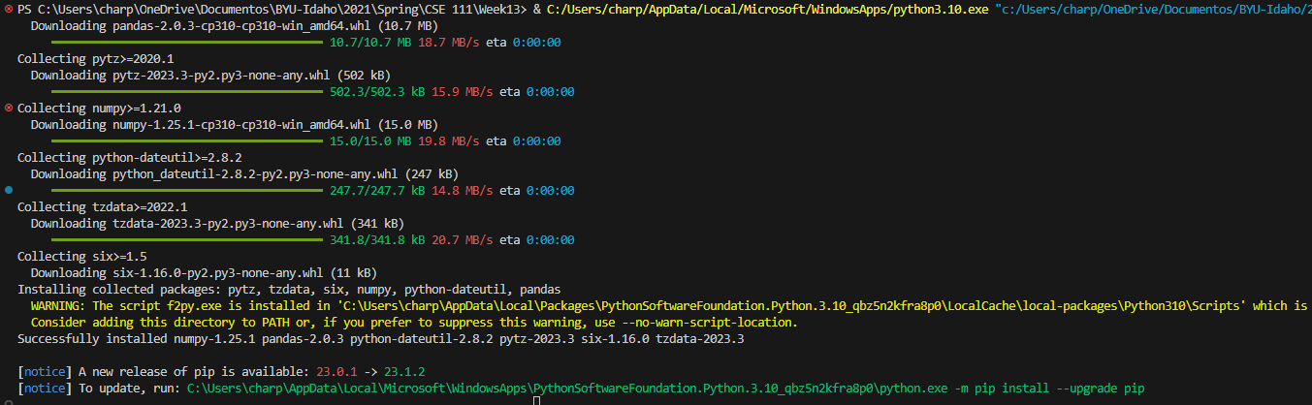
BOUNCE EMAIL PROJECT
MODULE PANDAS
Pandas is a versatile tool that makes working with data in Python more efficient and intuitive. Whether you need to clean and preprocess data, perform complex calculations, or analyze and visualize data, Pandas provides a user-friendly and efficient way to accomplish these tasks.
POWER AUTOMATE
Notes:
Pandas is a library in Python that provides easy-to-use data structures and data analysis tools. It is designed to handle and manipulate structured data, such as tables or spreadsheets, efficiently.

Slide 14

VISUAL STUDIO CODE

Slide 15
BOUNCE EMAIL PROJECT
VISUAL STUDIO CODE

Slide 16
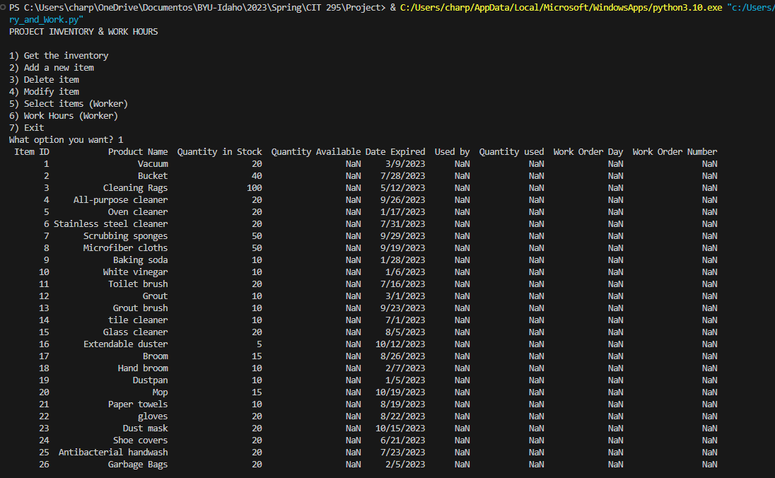
BOUNCE EMAIL PROJECT
OPTION 1
POWER AUTOMATE

Slide 17
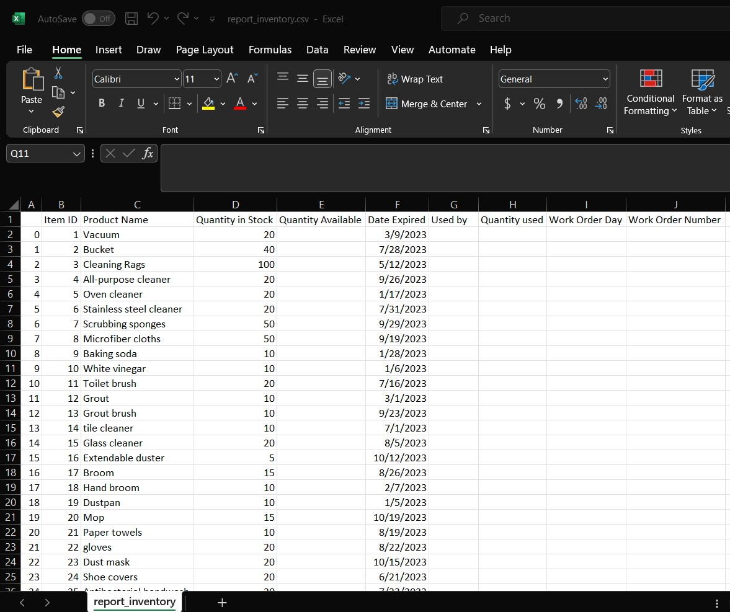
BOUNCE EMAIL PROJECT
OPTION 1
POWER AUTOMATE

Slide 18
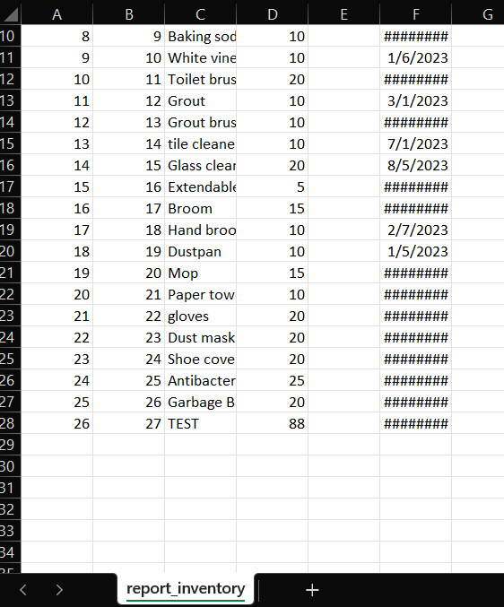
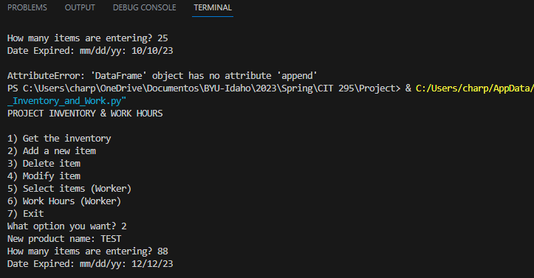
BOUNCE EMAIL PROJECT
OPTION 2
POWER AUTOMATE

Slide 19
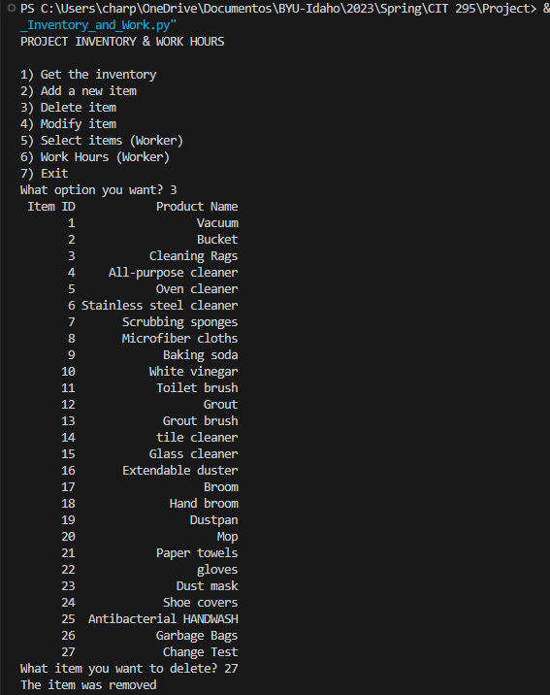
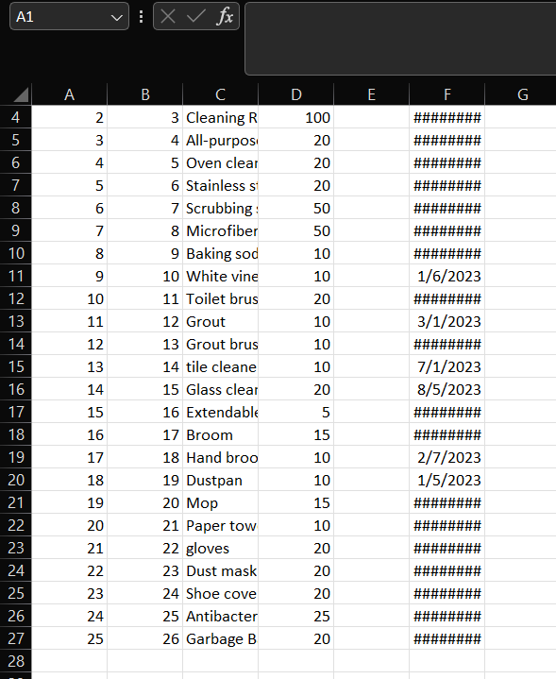
BOUNCE EMAIL PROJECT
OPTION 3
POWER AUTOMATE

Slide 20
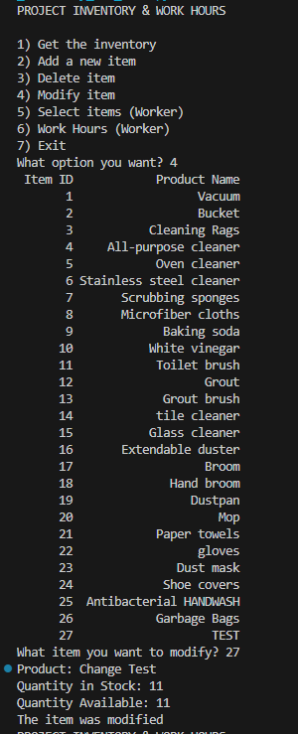
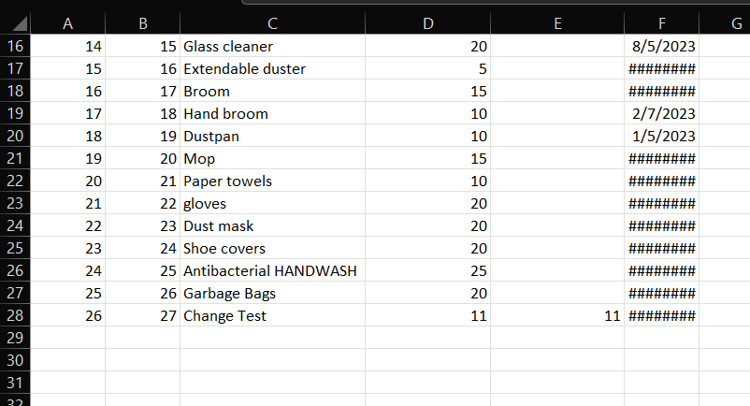
BOUNCE EMAIL PROJECT
OPTION 4
POWER AUTOMATE

Slide 21
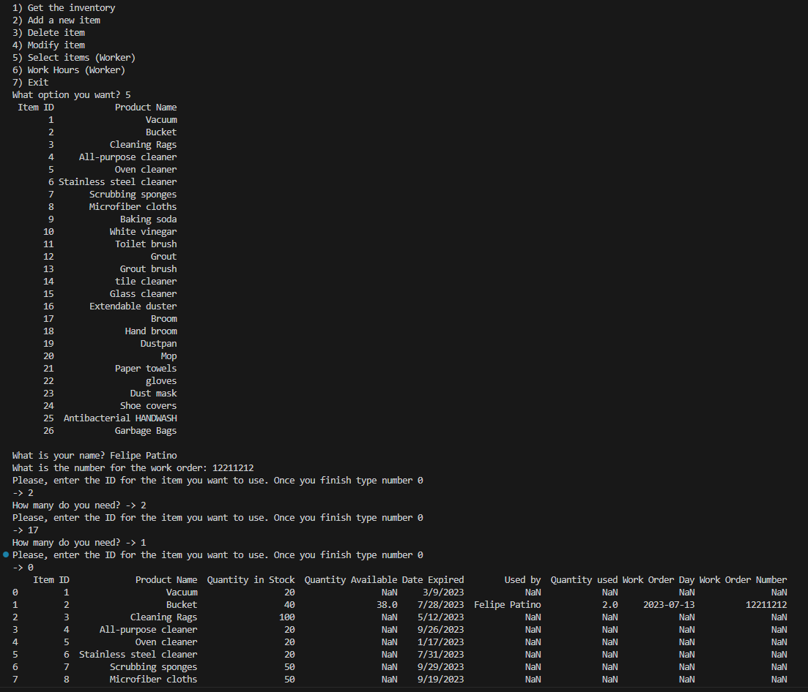
BOUNCE EMAIL PROJECT
OPTION 5
POWER AUTOMATE

Slide 22
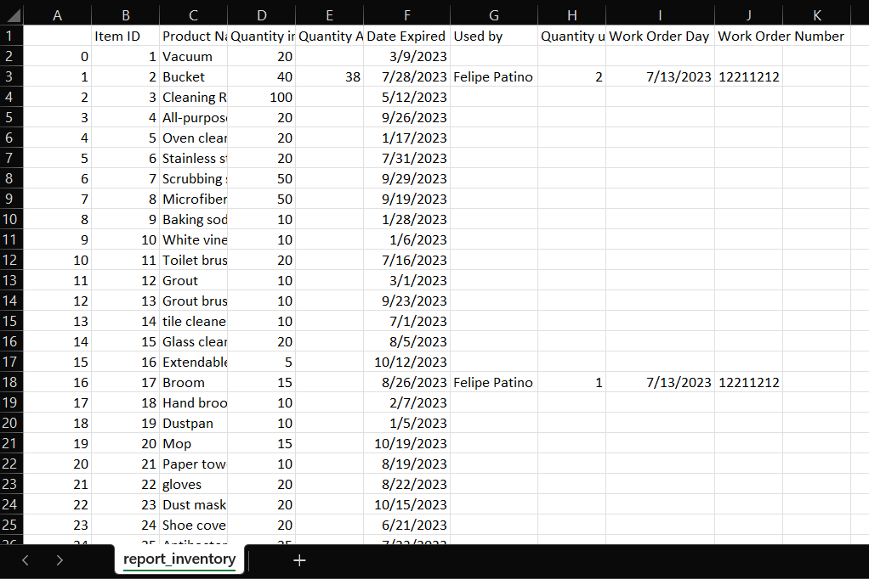
BOUNCE EMAIL PROJECT
OPTION 5
POWER AUTOMATE

Slide 23
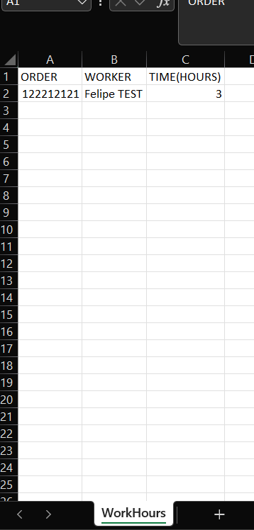
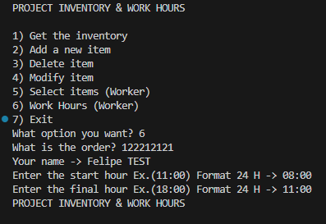
BOUNCE EMAIL PROJECT
OPTION 6
POWER AUTOMATE

